Slide 1
Privacy in the digital age - cases of S.korea
Byoungil Oh
Korean Progressive Network Jinbonet

Slide 2
01
Beginning of Privacy Movement
Privacy in the digital age – cases of s.korea

Slide 3
01
Electronic NID Card
Beginning of privacy movement
Privacy in the digital age – cases of s.korea

Slide 4
01
NEIS(National Education Information System)
Beginning of privacy movement
Privacy in the digital age – cases of s.korea

Slide 5
02
Supervisory Authority for Privacy
Privacy in the digital age – cases of s.korea

Slide 6
02
Personal Information Protection Commssion
Supervisory Authority for Protection
Before 2011
MOSPA for public sectors
Each Ministry for private sectors
PIPC
Based on PIPA
Launched on Sep. 2011
Supervisory authority for privacy
Privacy in the digital age – cases of s.korea

Slide 7
02
Personal Information Protection Commssion
Limitation of PIPC
Guideline
Additional Protocol to the Convention for the Protection of Individuals with regard to Automatic Processing of Personal Data regarding supervisory authorities and transborder data flows (Council of Europe)
Authoriy of PIPC
Deliberation and resolution
Limitation
Lack of powers of investigation, intervention, and order of corrective measure etc
Lack of Indepence
Supervisory authority for privacy
Privacy in the digital age – cases of s.korea

Slide 8
03
National Identification Number
Privacy in the digital age – cases of s.korea

Slide 9
03
Resident Registration Number (RRN)
Resident Registration Number
700908-1234567
Date of birth, gender, region of birth registration
Given at birth, unchangeable for one’s life
Unrestricted collection and use in public and private sectors
Mass Leakage of Personal Information
2014 : 104,000,000 cases, from KB, Lotte, NH Credit Card Companies
2012 : 8,730,000 cases from KT (Korea Telecom)
2011 : 13,200,000 cases from Nexson (game company)
2011 : 35,000,000 cases from SK nate (portal sites)
2008 : 18,630,000 cases from Auction (online market)
The # of leaked RRN : 400 mil. (8 times of Korean Population)
National identification number
Privacy in the digital age – cases of s.korea

Slide 10
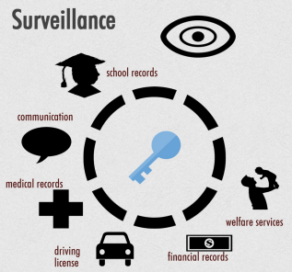
03
RRN and Surveillance
National identification number
Privacy in the digital age – cases of s.korea

Slide 11
03
Resident Registration Number (RRN)
How to Reform RRN
To Change to serial number which has no personal information
To be changeable, if necessary
To limit the collection and use of NIN
To use different number system in different sectors
National identification number
Privacy in the digital age – cases of s.korea

Slide 12
04
Communication Surveillance
Privacy in the digital age – cases of s.korea

Slide 13
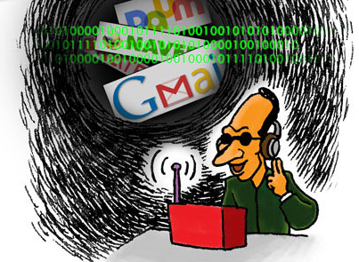
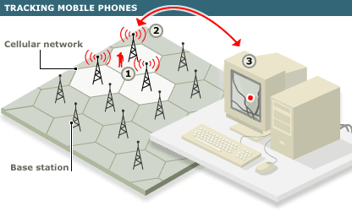
04
Communication Surveillane
Internet Packet Inspection
Real-time Location Tracking
The use of data from base station
Communication surveillance
Source : SIMON LAW GROUP
http://www.simonattorneys.com/blog/bid/95720/Police-Do-Not-Need-a-Warrant-to-Track-Cell-Phone-Location
Privacy in the digital age – cases of s.korea

Slide 14
Thank YOu

